Slide 1

Core Java

Slide 2
Core Java
Platform Independent
Advantages of Java over .net & php
Command line Arguments
History
JDK, JRE, JVM
Arch of JVM
Datatypes
Variables vs Constants
equals vs ==
If, while, do-while, switch, for, enhance for loop

Slide 3
WHAT IS JAVA?
Object Oriented Programming
WORA( Write Once Run any where)
The Java language was created by James Gosling in June 1991.
Java Provides development and deployment environment.
It is similar in syntax to C++
It is robust provides exception handling , automatic garbage collection.
Supports Multithreading
Secure ( No Pointer and Byte Code Verifier)
High Performance (JITc)

Slide 4
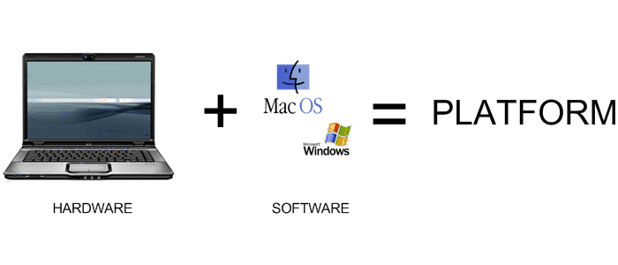

Platform Independent
32bit / 64bit

Slide 5
Platform Independent
What is Platform Independent
Write code in one machine and execute the code on another machine
Write code on Linux and execute it on Windows or Mac
Platform
OS
Hardware
WORA
Write Once Run Anywhere

Slide 6
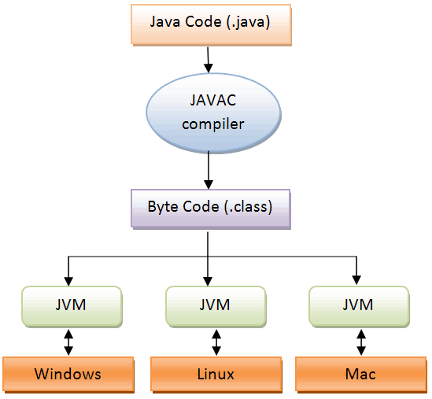
Bytecode makes
Java Platform Independent
C Code (.c)
C Code (.c)
C compiler
C compiler
Windows Code
Linux Code
Windows
Linux
Native Code
Native Code

Slide 7
Platform Independent
Bytecode
Machine level language of Java Virtual Machine (JVM)
Bytecode execution in java proves to be platform independent
Source Code
Javac
Byte Code

Slide 8
Platform Independent
Platform independent
Written code can be run on any machine

Slide 9

Java as Platform Independent
Compiling .java file generates .class file and it contains bytecode
Bytecode is platform independent you can run it on any machine

Slide 10


Java as Platform Independent
Using javac
Source Code
Byte Code
class{
public static void main(String[] args){
System.out.print(“Hello World”);
}}
0011110001110001111111010111000111000111100011100001111000011110000000000000000000000111111011111110111111110000000001
Compile
Generates
JVM
Output
Notes:
JIT compiler - converts source code into native code just before running the program
JIT Compiler – Just in time Compiler

Slide 11


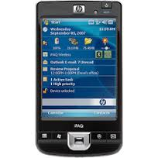
Java as Platform Independent
Source Code
Compile
Compile
Source Code
Written on mac
Written on Windows
Byte Code
JVM
JVM
JVM

Slide 12
JVM as Platform Dependent
JVM translates bytecode into machine language
Used primarily to
Translate the bytecode into the machine language for a particular computer
Execute the corresponding machine-language instructions
The JVM and bytecode combined give Java its status as a "portable" language – this is because Java bytecode can be transferred from one machine to another
Notes:
Machine language is OS dependent
Given the previous information, it should be easier to figure out an answer to the original question. Since the JVM must translate the bytecode into machine language, and since the machine language depends on the operating system being used, it is clear that the JVM is platform (operating system) dependent – in other words, the JVM is not platform independent.

Slide 13
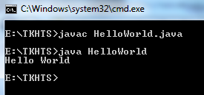
Java First Program
HelloWorld.java
public class HelloWorld {
public static void main(String[] args) {
System.out.println("Hello World");
}
}
Output

Slide 14
JAVA vs .NET vs PHP
JAVA | .NET | PHP
Platform independent, Based on Wora Principal since day one | Dream to be platform Independent one day. Mono project implement to run .NET on linux | Platform independent but when it comes to network programming it is “handicapped”
Open Source | Commercial | Open Source
Single Language | Multi Language
Open Source Communities build 3rd party utilities (Java frequently gets update) | In house tools used or 3rd party most of the commercial tools | Open Source Communities build 3rd party utilities
Bytecode | MSIL –(Microsoft Intermediate Language) | Runs on server
JRE – Java Runtime Environment | CLR – Common Language Runtime | Runs on server
Mobile Apps - Android | Mobile Apps - Windows
 |  | Not for desktop applications
 |  | Poor support for handling errors
Notes:
PHP Error Handling
When creating scripts and web applications, error handling is an important part. If your code lacks error checking code, your program may look very unprofessional and you may be open to security risks
Error handling is the process of catching errors raised by your program and then taking appropriate action.

Slide 15
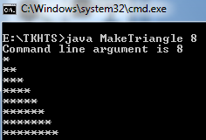
Command Line Arguments
Java application can accept any number of arguments from the command line
Allows users to specify information when the application is launched
Suppose a Java application called MakeTriangle creates a triangle. To give the number of rows at runtime:
Command line argument

Slide 16

How Many Ways To Write Java
Main
A main method/entry point to a program can be declared in many ways but
Must have static and public modifiers
Must return void
Must have String array as parameter
public static void main(String a[])
public static void main(String[] a)
static public void main(String[] b)
public static void main(String... java)
public static void main(String name[]) static public void main(String[] grades)

Slide 17
Create Own Main Methods
We can have our own main methods as well
package com.tkhts;
public class ManyMains {
public void main(){
System.out.println("My main method.");
}
public String main(String str){
return str;
}
public static void main(String[] args) {
System.out.println("Java main method starts here.");
ManyMains mains = new ManyMains();
mains.main();
System.out.println(mains.main("My String type main method."));
System.out.println("Java main method ends here.");
} }

Slide 18


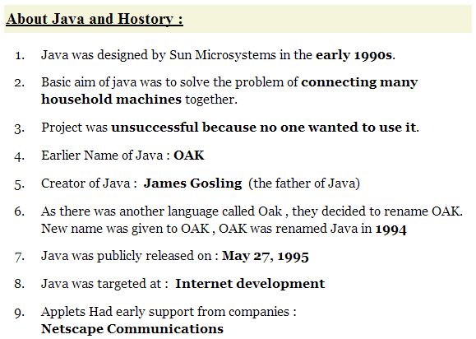

Java History
Java History:

Slide 19
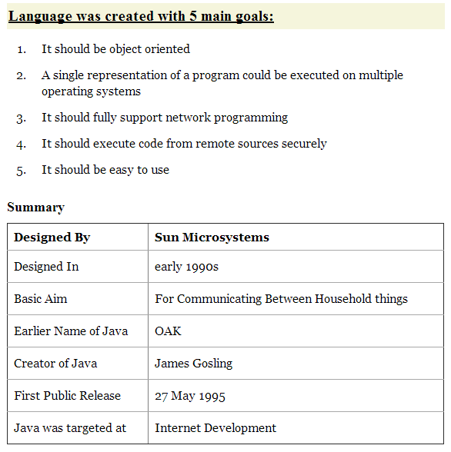
Java History

Slide 20
JDK, JRE, JVM
Java Comprises two things
JDK & JRE
JRE is subset
JDK
JVM is subset
JRE & JDK
JDK
javac, jar, javap, etc.
JRE
java, javaw, rt.jar, libraries
JVM
JIT, Interpreter

Slide 21
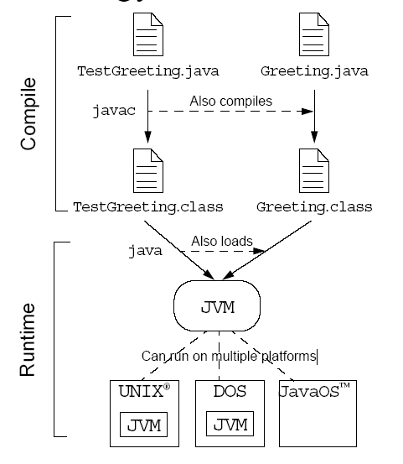
JDK, JRE, JVM

Slide 22
JDK, JRE, JVM
JDK | JRE | JVM
Java Development Kit | Java Runtime Environment | Java Virtual Machine
Platform dependent | Platform dependent | Platform dependent
Comes as installer, JDK installation also installs JRE and JVM | Comes as installer, JRE installation also installs JVM | Comes with JRE installation
JDK = javac compiler + .jar (libraries) + javadoc + JRE | JRE=JVM + jar files (libraries) | JIT Compiler and Interpreter
Compiles the java application, creates bytecode (.class) | Creates the runtime environment to java application | Converts the byte code to native code
Notes:
JVM, JRE and JDK are platform dependent

Slide 23
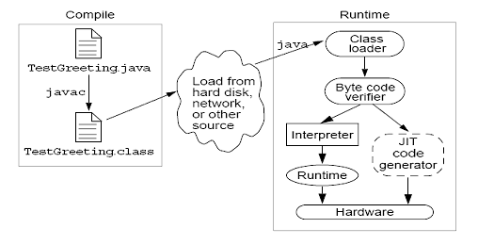
Architecture JVM

Slide 24
Datatypes
There are two data types available in Java:
Primitive Data Types
Reference/Object Data Types
data_type variable = value;
int num = 55;
data_type variable = new data_type(value);
String name = new String(“TKHTS”);

Slide 25
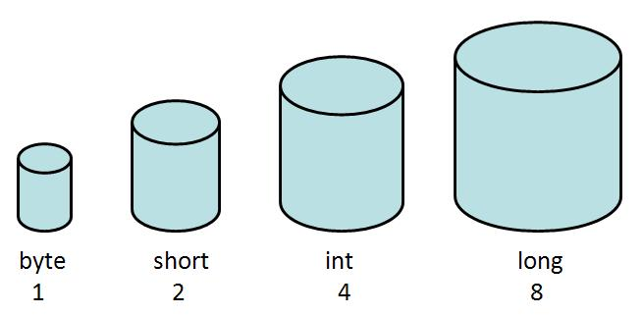
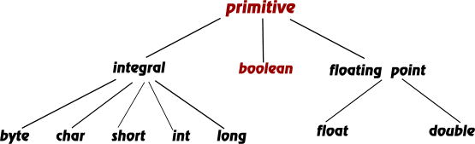
Datatypes
Primitive Data Type
Primitives are like the cups at the Coffee-House
Comes in different sizes and each has name like small , big, medium
large
big
medium
small

Slide 26
Datatypes
Primitive Datatype in java
Data Type | Memory Size | Default Value | Declaration
byte | 8 bits | 0 | byte b = 15;
short | 16 bits | 0 | short s = 75;
int | 32 bits | 0 | int a = 2786;
long | 64 bits | 0 | long l = 31786;
float | 32 bits | 0.0f | float f = 3.14f;
double | 64 bits | 0.0 | double d = 36.1554;
char | 16 bits | ‘u0000’ | char c = ‘x’;
boolean | JVM Dependent | false | boolean b = true;

Slide 27
Datatypes
Reference Data Types
Created using defined constructors of the classes
Used to access objects
Declared to be of a specific type that cannot be changed
Employee
Student
Class objects, and various type of array variables come under reference data type
Default value of any reference variable is null
String name = new String(“TKHTS”);

Slide 28
Primitive Vs Reference Type
int a=100;
int b=200;
int c=a;
String a=new String(“tkhts”);
String b=new String(“tkhts.com”);
String c=a;
a
a
tkhts object
reference
100
tkhts
b
b
tkhts.com object
reference
200
c
tkhts.com
c
tkhts object
reference
100
HEAP
Primitive Type
Reference Type
Notes:
A reference is sort of like a pointer that you can't do arithmetic on.
if you're used to thinking of a pointer as "a way of identifying an object or navigating to it" (in some sense) then yes, those thoughts apply to references too.
E.g. If reference variable is null , and still u r accessing the members through the reference variable it will through NullPointorException , which give the hint the reference is acting like a pointer internally.
NOTE : In Java u can not get the reference of the Object.
The only operations allowed are to set it (from another reference) and to reference through it to the referred-to object. It can be set from a reference-valued expression, such as the new operator, or from another reference (which is syntactically a simple reference-valued expression).
HashCode never respresents reference because , reference can be 64 bit and hashcode returns int only.
So it is also same for the System.identityHashCode(obj).
***************************************************************************
A a = new A();
A b = new A();
A c = a;
In the above example , a and c having the same reference for the same object. Since they refer to the same object their hashcodes will be equal.
But a and b do not refer to the same object. They are references to 2 different objects, But they might have the same hashcode based on their implementation.
Note : The Address/Reference to an object points to the location in memory that an object lives.
A HashCode is generated via a Hashing Algorithm and is used to identify objects in a hash collection.
In Java , every class inherit the parent class as an object class. So every class has a chance to override the hashcode().
An object hash code allows algorithms and data-structures to put objects into compartments (Buckets).
So This technique makes object search faster.
The HashMap and HashSet use the same concept.
Note: Objects that are equal must have the same hashcode within a running process.
HashCode is return int so range is (2 ^ 32).
HashCode Collision
Whenever 2 objects have the same hashcode, we call this a collision.
A collection is nothing critical it just means that there is more than one object in a single bucket.
System.identifyHashCode(object)
This method provides the hashcode of the provided object as would be returned from its ultimate (java.lang.Object class HashCode Implemented Hascode it gives).
It gives Object parent, regardless of whether the passed-in object overide the hashcode method.

Slide 29
Variables
Location in memory where a value is stored and retrieved
Defining a variable
Must tell the compiler what kind of variable it is
Must declare all variables before they can be used
datatype variable1 = value1, variable2 = value2 ;
int a = 10, b, c = 225;

Slide 30
Variables
Instance Variables (Non-Static Fields)
Objects store their individual states in "non-static fields” or ”instance variables”
thecurrentSpeed of one bicycle is independent from the currentSpeed of another
Class Variables (Static Fields)
Class variable declared with the static modifier
Exactly one copy of this variable for every object of this class
Local Variables
Similar to an object, a method will often store its temporary state in local variables.
Parameters
Recall that the signature for the main method is public static void main(String[] args). Here, the args variable is the parameter to this method

Slide 31
Variable Naming
Case-sensitive
Legal identifier
Unlimited-length
Can only begin with a letter, "$” or "_“
Can have digit
But can not be started with
Without space
Lowercase letters
Have uppercase letter if for first character if more than one word
double _num;
char char;
int _;
int $;
float __;
short age and tme;
String myName;
boolean is_True;
int for;

Slide 32
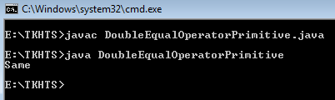
equals vs ==
“==” operator with primitive datatypes
Used to compare the values of two variables
Returns ‘true’ when matched otherwise ‘false’
int a = 10;
int b = 10;
if(a==b)
System.out.println("Same");
else
System.out.println("Not Same");

Slide 33
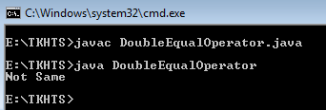
equals vs ==
“==” operator with reference datatypes
Used to compare two objects reference not the value
Checks if the objects refer to the same place in memory
String str1 = new String(“TKHTS");
String str2 = new String(“TKHTS");
if(str1 == str2)
System.out.println(“Same");
else
System.out.println(“Not Same");

Slide 34
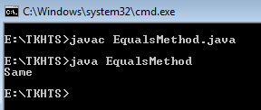
equals vs ==
equals() method in reference datatypes
Compares the contents of two objects
Not their location in memory
String str1 = new String(“TKHTS");
String str2 = new String(“TKHTS");
if(str1.equals(str2))
System.out.println(“Same");
else
System.out.println(“Not Same");

Slide 35
Constants
An exact and unchanging value
Declare the variable as final to make it constant
Recommended to name the constants only in uppercase
final double PI = 3.14159;
Value of this variable can not be changed
Notes:
It is important to use the combination of static and final operators for things that are really constant.

Slide 36
Decision Making Statements
if – else
switch
false
Condition
If the condition (Boolean expression) evaluates to true then the block of code inside the if statement will be executed
true
Restricted Statement Block
If not, statements after the closing curly brace will be executed
Statement Block

Slide 37
Decision Making Statements
if
if – else
Can be nested
int bought = 260;
int sold = 320;
if(bought<sold){
System.out.println(“Profit");
}
else if(bought == sold){
System.out.println(“No Gain No Loss”);
}
else {
System.out.println(“Loss”);
}

Slide 38
Decision Making Statements
switch
Allows a variable to be tested for equality against a list of values
Each value is called a case and the variable is checked for each case
Rules:
variable used can only be a byte, short, int, or char
You can have any number of case statements followed by the value to be compared to and a colon
Data type must be same of case variable and switch variable
Switch statements will be execute until a break statement is reached
Default case can be used for performing a task when none of the cases is true

Slide 39
Decision Making Statements
int a = 3;
switch(a){
case 1:
System.out.println("This is North");
break;
case 2:
System.out.println("This is East");
break;
case 3:
System.out.println("This is West");
break;
case 4:
System.out.println("This is South");
break;
default:
System.out.println("This is not a direction");
}
String dir = “North”;
switch(dir){
Switch allowed
String in Java7

Slide 40
Loops
Situation when we need to execute a block of code number of times is often referred to as a loop
There is a variety of loops in java
while
do – while
for
Enhance for loop
iterator loop

Slide 41
While Loop
Control structure that allows to repeat a task a certain number of times
Syntax:
while(Boolean_expression)
{
//Statements
}

Slide 42
Do-While Loop
Similar to while loop but it first gets executed and then checks the condition
Guarantee to execute at least one time
Syntax:
do
{
//Statements
} while(Boolean_expression)

Slide 43
For Loop
Control structure that allows to repeat a task a certain number of times
Useful when you know how many times a task is to be repeated
If condition is not true jumps out from the loop
Initialize loop control variables (only once)
for(initialization; condition; iteration)
{
//Statements
}
After the body of this loop, the flow of control jumps back up to the iteration and checks the condition

Slide 44
Enhanced For Loop
Java 5 introduced the enhanced for loop
Takes the value from the array one by one and enters the loop with every value. Datatype must be same as of array
for(datatype declaration : array_like_expression)
{
//Statements
}

Slide 45
Iterator Loop
Java 5 introduced the iterator loop
Must be same as type of object
Iterator <String> iterator = list.iterator();
while (iterator.hasNext())
{
System.out.println(iterator.next());
}
Takes each value one by one and enters the loop for each value, if value is not found false is returned

Slide 46

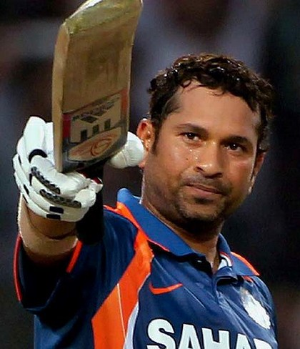
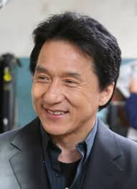



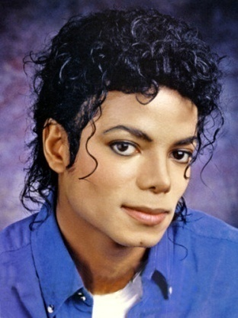
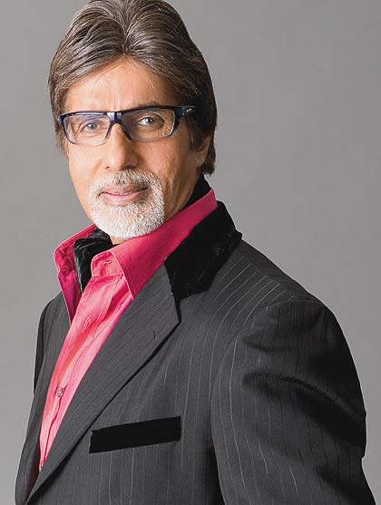


Class Vs Object

Slide 47







Class Vs Object
Actors
Players
Singers

Slide 48
Class Vs Object
Actors
Players
Singers
Name
Debut date
No of movies
Hits
First movie
Nationality
Name
Debut date
No of movies
Hits
Man of the match
Nationality
Name
Debut date
No of tracks
Hits
Nationality

Slide 49







Class Vs Object
Actors
Players
Singers
class Actor
{
string Name
date Debut-date
int No-of-movies
int Hits
string First movie
string Nationality
}
class Player
{
string Name
date Debut-date
int MatchesPlayed
int Man of the match
string Nationality
}
class Singer
{
string Name
date Debut-date
int No-of-tracks
int hits
string Nationality
}

Slide 50






Multithread
Salary System
Employees who got their salary
It takes 1 min to deal with each employee
Ramesh
Ram
Tim
Ram
Tim
Tim
Miley
Tim
Emp * 1 min =
Miley
Miley
Rahul
Employee Queue
Miley
Rahul
Rahul
Mike
How much it will take for 100 employees
Sachin

Slide 51
Multithread
Salary System
Ramesh
5Emp * 1 min =
Sachin
Miley
Ram
Das
Kim
Tim
Jimmy
Mike
Tom
Dolly
Dev
John
Adam
Carl
How much it will take for 100 employees

Slide 52
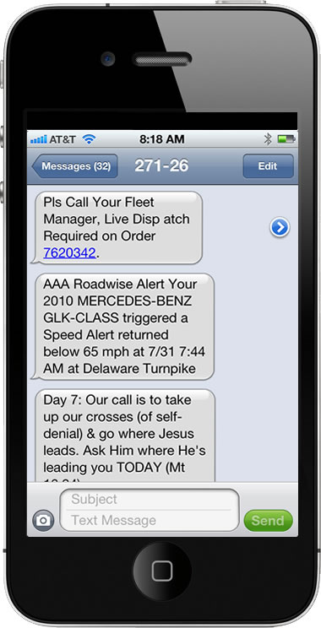
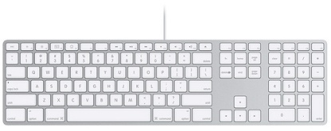
Exception
I am about to reach
I am about to reach
Network error

Slide 53
Exception

Slide 54
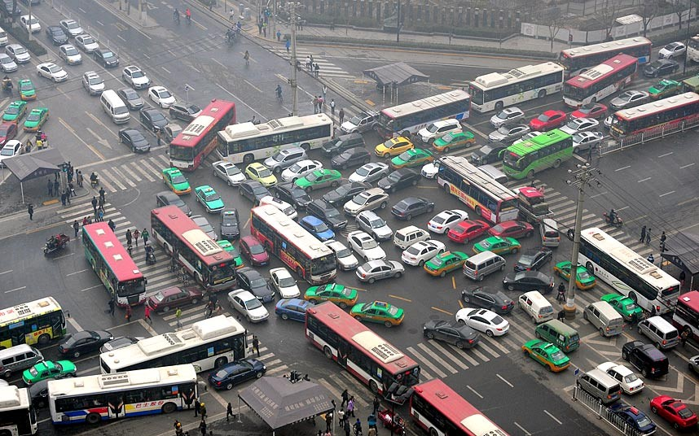
Exception

Slide 55
JAVA vs .NET vs PHP
JAVA | .NET | PHP
Platform independent, Based on Wora Principal since day one | Dream to be platform Independent one day. Mono project implement to run .NET on linux | Platform independent but when it comes to network programming it is “handicapped”
Open Source | Commercial | Open Source
Single Language | Multi Language
Open Source Communities build 3rd party utilities (Java frequently gets update) | In house tools used or 3rd party most of the commercial tools | Open Source Communities build 3rd party utilities
Bytecode | MSIL –(Microsoft Intermediate Language) | Runs on server
JRE – Java Runtime Environment | CLR – Common Language Runtime | Runs on server
Mobile Apps - Android | Mobile Apps - Windows
 |  | Not for desktop applications
 |  | Poor support for handling errors
Notes:
PHP Error Handling
When creating scripts and web applications, error handling is an important part. If your code lacks error checking code, your program may look very unprofessional and you may be open to security risks
Error handling is the process of catching errors raised by your program and then taking appropriate action.

Slide 56
JAVA vs C
Thing | C | Java
Type of language | Function oriented | Object oriented
Portability of source code | Possible with discipline | Yes
Portability of compiled code | No, recompile for each architecture | Yes, bytecode is "write once, run anywhere"
Joint compilation | Gcc main.C helper1.C helper2.C | Javac main.Java - any dependent files are automatically re-compiled if needed
Memory address | Pointer | Reference
Allocating memory | Malloc | New
De-allocating memory | Free | Automatic garbage collection

Slide 57
JAVA vs C
 | Java | C
JIT | JVM support | None
Garbage Collection | Native Support | None
Connection Pooling | Native Support | None
Rich API | Too much | Very little
Reflection | Native Support | Native Support
Packaging and deployment | Native Support | None
Debugging | Native Support | None
UI support | Applet, Swing, JSF, JavaFX | None
Annotations | Native Support | None
Internationalization(i18N)/ Localization(i10N) | Native Support | Not sure
Threads | Native Support | None

Slide 58
JAVA is written in ??
The Sun JVM is written in C
JVM run on your machine is a platform-dependent executable
Hence could have been originally written in any language
The Oracle JVM (HotSpot) is written in the C++ programming language
Java Compiler provided By Oracle is written in JAVA itself

Slide 59

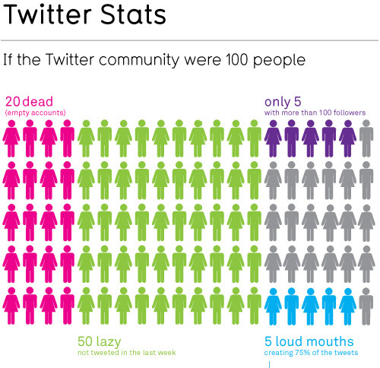

Distribute Salary ??

Slide 60
Distributed Environment
2GB Machine
4GB Machine
UI
BL
DB
Salary System
Company Acc No
9131458744
Debit
Credit
Employee Acc No
4125586954
Transfer Salary
1 Transaction = 2MB
Max. no of transactions = 2GB / 2MB = 1024
Vertical Scaling
Horizontal Scaling

Slide 61
Distributed Environment
2GB Machine
2GB Machine
UI
BL
DB
Salary System
Company Acc No
9131458744
Debit
Credit
Employee Acc No
4125586954
Transfer Salary
JVM
JVM
JVM

Slide 62
Multithread
UI
BL
DB
Salary System
Company Acc No
9131458744
Debit
Credit
Employee Acc No
4125586954
Transfer Salary
1 Transaction = 1min
= 166hr 40min
10,000 transactions = 10,000min
= 1666hr 40min
1,00,000 transactions = 1,00,000min

Slide 63
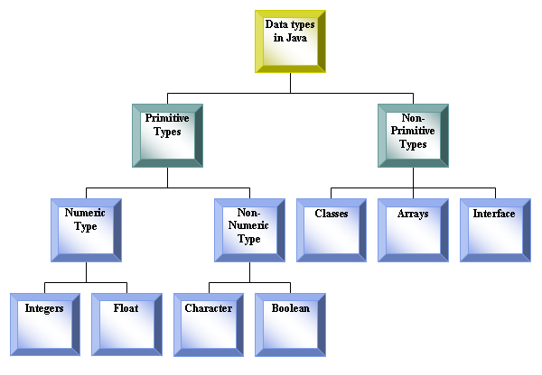
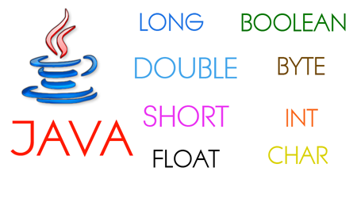
Datatypes

Slide 64
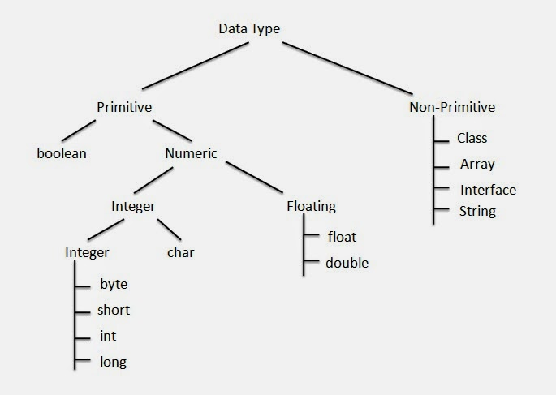
Datatypes

Slide 65
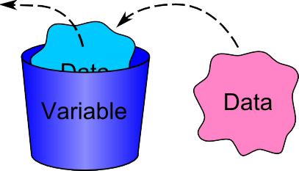
Primitive Vs Reference Type
int a=100;
int b=200;
int c=a;
a
100
b
200
a
100
c
100
Primitive Type

Slide 66
Primitive Vs Reference Type
class Person{
String name;
int age;
}
Person ram = new Person();
ram.name=“Ram”;
ram.int age=24;
name
ram
2a55deb44b33
name
Ram
age
24
age
24
Ram
Reference Type

Slide 67
Primitive Vs Reference Type
Primitive Data Type
Boolean
Numbers
Characters
JVM dependent
Integers
Real Numbers
char
16bits
double
64bits
float
32bits
long
64bits
short
16bits
int
32bits
byte
8bits

Slide 68
Primitive Vs Reference Type
Primitive Data Type
Boolean
Numbers
Characters
JVM dependent
Integers
Real Numbers
char
16bits
double
64bits
float
32bits
long
64bits
short
16bits
int
32bits
byte
8bits

Slide 69
What Data Type ??
double
64bits
int
32bits
A
A
long
64bits
124
124
17.3
17.3
char
16bits
Ram
Ram
short
16bits
float
32bits
32768
32768
byte
8bits
32767
32767

Slide 70
Primitive Vs Reference Type
ram
dan
Person ram = new Person();
ram.name=“Ram Kumar”;
ram.int age=24;
mike
ram
name
Ram Kumar
age
jack
carl
24
Person shyam = new Person();
shyam.name=“Shyam Kapoor”;
shyam.age=29;
shyam.address=“Delhi”;
tim
class Person{
String name;
int age;
String address;
long contact;
String email;
}
tom
mohan
shyam
shyam
name
Shyam Kapoor
age
29
address
Delhi

Slide 71
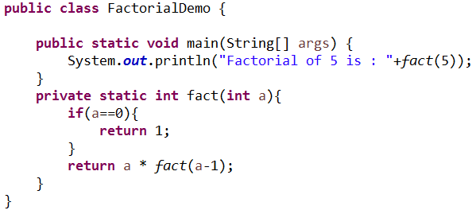
Factorial
0
1
1
1
2
2
3
6
4
24
5
120
fact(5)
5*24
fact(4)
4*6
fact(3)
3*2
fact(2)
2*1
fact(1)
1*1
fact(0)
1

Slide 72
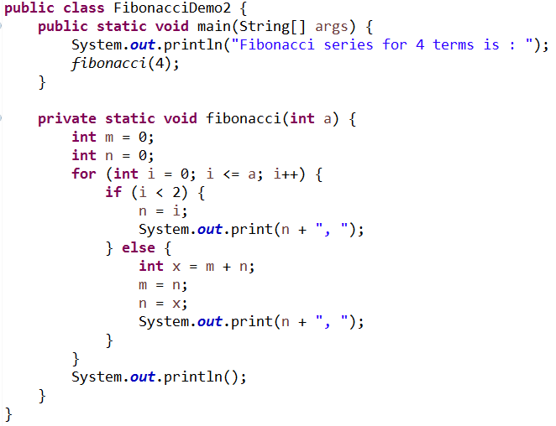
Fibonacci
0
1
i = 0
i = 1
i = 2
i = 2
i = 3
1
n = 0
n = 1
2
m = 0
m = 1
m = 2
3
n = 1
n = 2
n = 1
n = 3
5

Slide 73
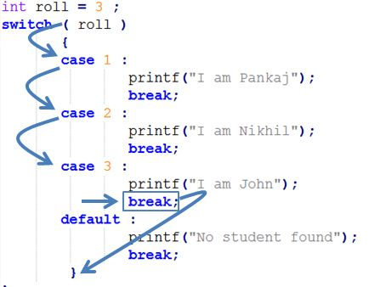
Switch Case

